Slide 1
ECG Classification + Domain Adaptation/Generalization
魏煜华
2020.11.17

Slide 2

Domain adaptation
Domain adaptation中文名称是域自适应学习，可以有效处理训练数据与测试数据具有不同分布的问题。
两个概念：source domain (源域) / target domain (目标域)，对应于机器学习任务的训练集和测试集。

Slide 3
Domain Generalization
Domain generalization是Domain adaptation中的一种特殊的技术，其目的是基于domain adaptation技术学习对于任何不可见的target domain的具有很强鲁棒性的分类器。
所谓不可见的target domain是指在分类器的训练过程中，我们并不知道target domain的任何情况。
这项技术有两个主要的难点：1.目标域不可见 2.要对任何目标域都起作用。
目前成熟的Domain Geneneralizartion技术主要有3类：
feature-based method：设计跨域不变特征来实现domain generalization
classifier-based method：针对每个源域数据集中的每一个子域对子分类器进行设计，然后将子分类器结合成一个融合分类器来实现
instance-reweighting method

Slide 4
ECG Classification + Domain Adaptation

Slide 5
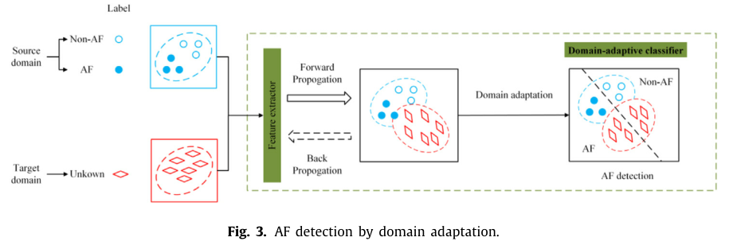
A novel Domain Adaptive Residual Network for automatic Atrial Fibrillation Detection
Inspired by the domain adaptation techniques, this paper proposes a novel Domain Adaptive Residual Network (DARN) to detect AF.
Key components:
Residual network to extract deep features from ECG signals
Multi-layer Maximum Mean Discrepancy to reduce distribution discrepancy between source and target

Slide 6
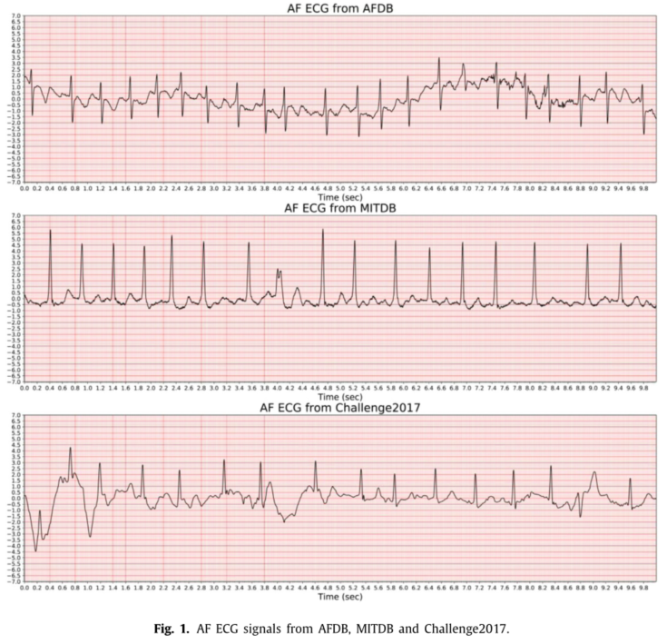

Slide 7
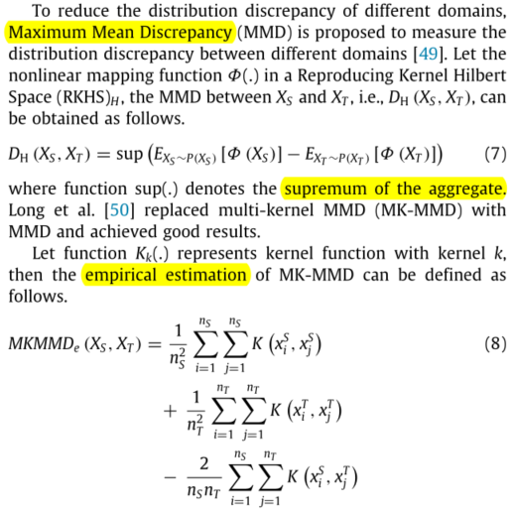
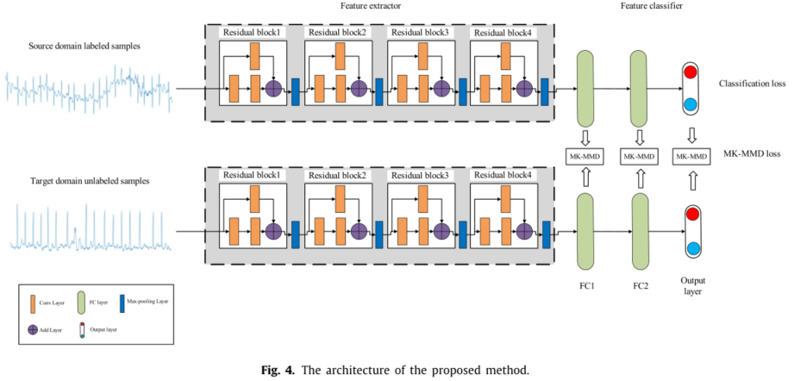
Method
ResNet + MK-MMD loss
Due to the MK-MMD, the network adjusts parameters in the training process, so that the target domain distribution is closer to the source domain after automatic feature extraction. Thus, combined with classification loss, the objective of model training is to not only make target domain distribution close to the source domain but classify samples from source domain dataset accurately, which ensures the model achieving good performance in the target domain.

Slide 8
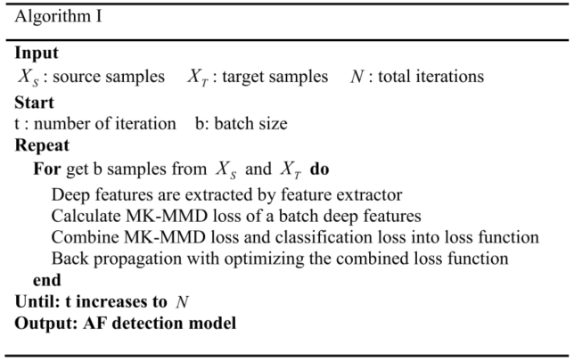
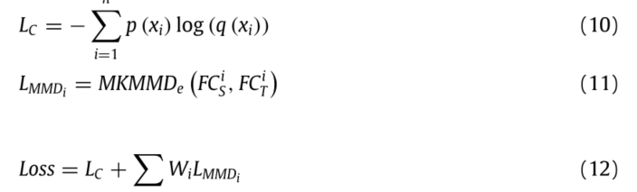
Method
Model training process

Slide 9
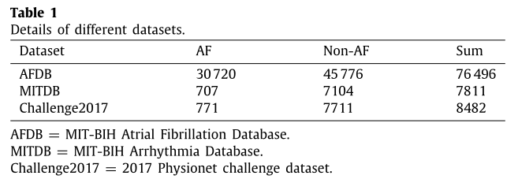
Datasets
ECG signals are divided into 10s ECG samples for subsequent experiments.
As for AFDB and MITDB, a 10 s ECG sample is labeled as AF when the percentage of annotated AF is p and a 10 s ECG sample is labeled as Non-AF when the percentage of annotated AF is 1 − p. In this study, we choose p as 100% to guarantee the balance between better diagnostic performance and shorter delay.
Combine all categories except AF into Non-AF, including MISSB, PSE, TS and so on in the MITDB.
Challenge2017 consists of Normal, Noise, AF and Other rhythm and we randomly select 10 s ECG signal for each record. Notably, due to the unequal length of ECG recordings in the Challenge2017, we use 0 to fill the rest part of the ECG record less than 10 s to obtain 10 s ECG signals, and intercept 10 s ECG signals for ECG recordings more than 10 s. In this study, we delete Noise and combine Normal and Other rhythm into Non-AF and then use AF and Non-AF signals to build Challenge2017 dataset.

Slide 10
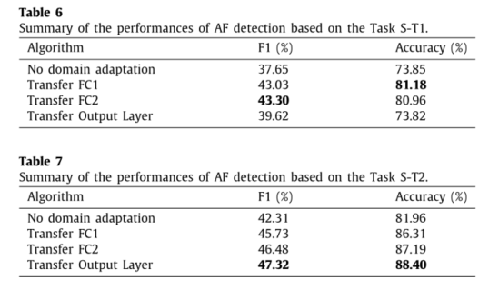
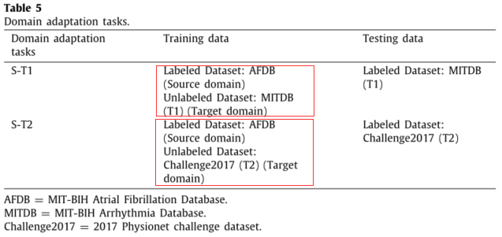
Tasks
Model improvement on target domain

Slide 11
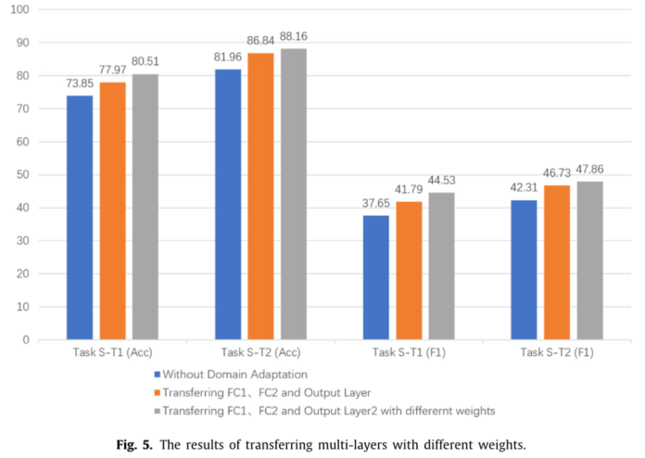
Tasks

Slide 12
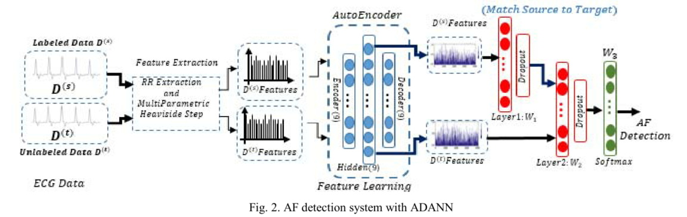
Atrial Fibrillation Detection with a Domain Adaptation Neural Network Approach
We propose an Asymmetric domain adaptation neural network (ADANN), which is composed of the three main parts:
A Denoising Auto Encoder (DAE) for learning a new feature representation that is more discriminative
FC layer to map data of the source domain to the domain of target domain
FC layer for feature classification.

Slide 13
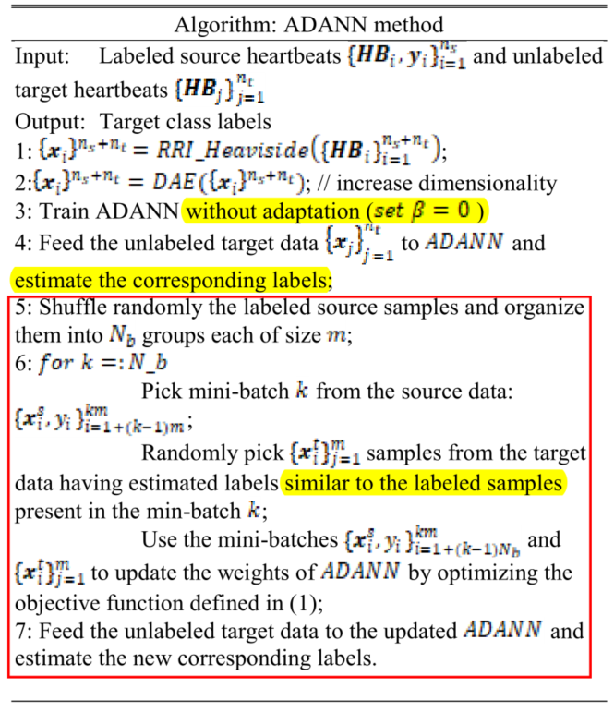

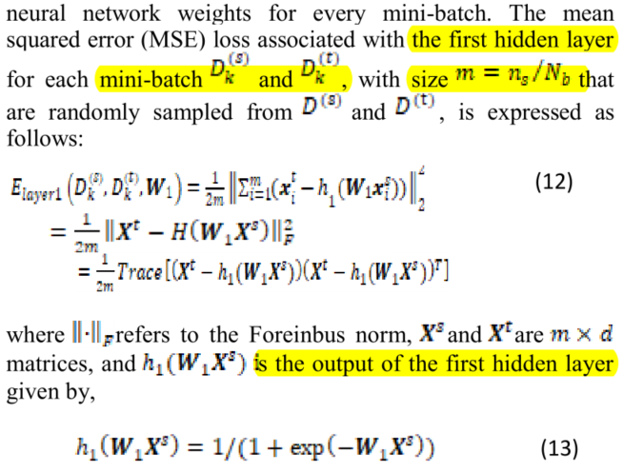
Atrial Fibrillation Detection with a Domain Adaptation Neural Network Approach

Slide 14
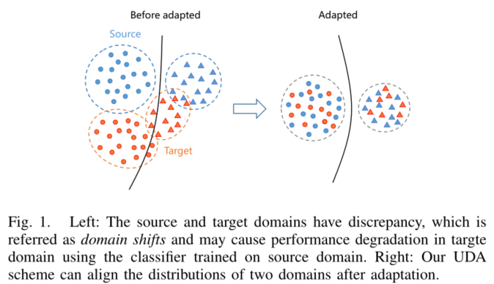
Unsupervised Domain Adaptation for ECG Arrhythmia Classification
We propose a novel unsupervised domain adaptation scheme to inter-patient ECG classification
Multi-path Atrous Conv Network (MACN) to tackle ECG beat classification
Cluster-aligning loss: align the distributions of training and test data
Cluster-separating loss: increase the discriminability

Slide 15
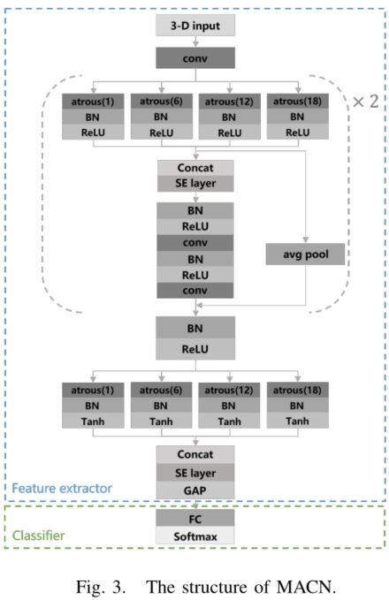
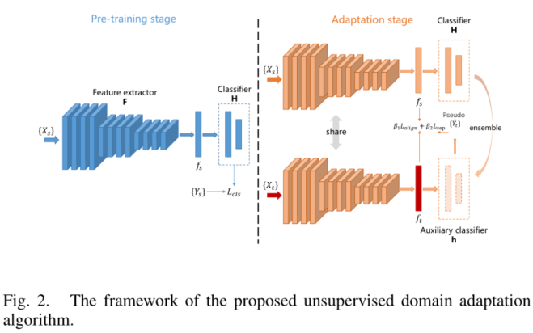
Framework

Slide 16
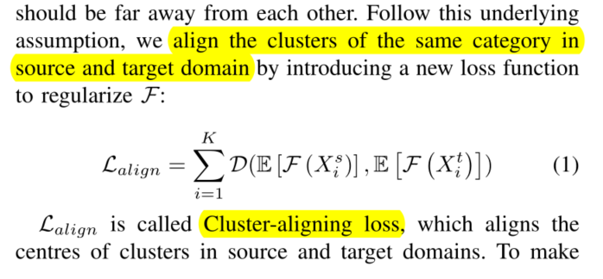
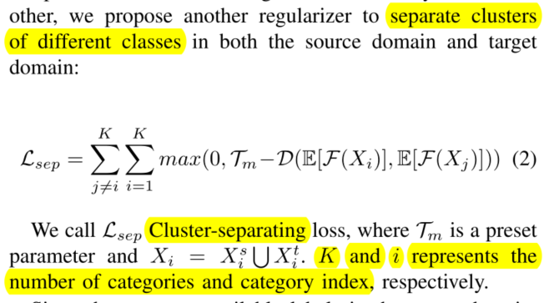
Cluster-Aligning Loss and Cluster-Separating Loss
A fundamental assumption in the classification task is cluster hypothesis
Samples of the same category should be in the same cluster, while samples belonging to different categories should be far away from each other.
Apply a pre-trained model to obtain pseudo labels for the unlabelled samples
The impact of incorrect pseudo labels: only use samples with high prediction confidence (>= 0.9)

Slide 17
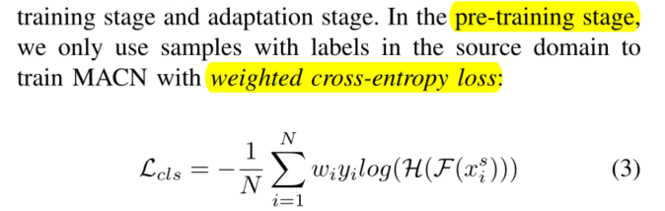
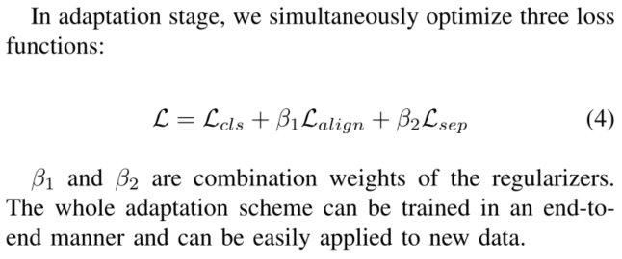
Optimization

Slide 18
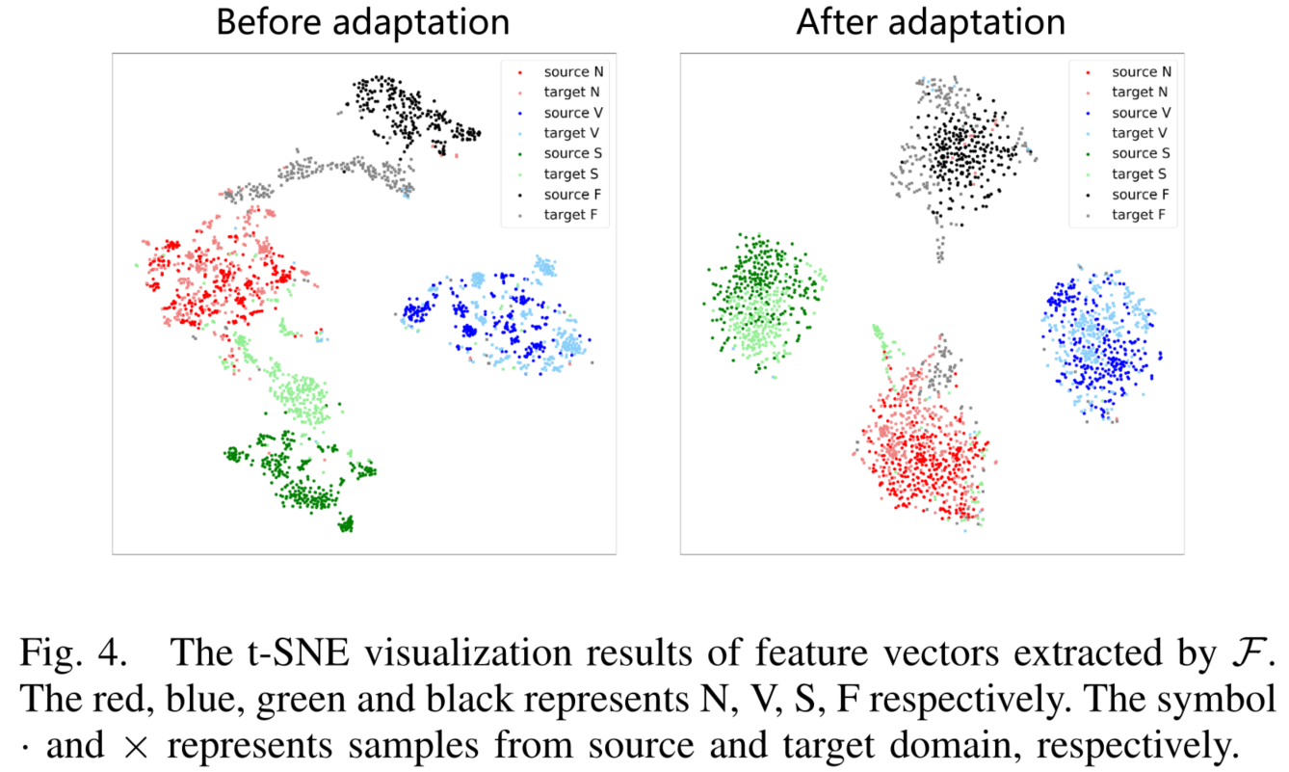
Results
MIT-BIH Arrhythmia Database
Two subsets with different patients

Slide 19
ECG Classification + Domain Generalization

Slide 20
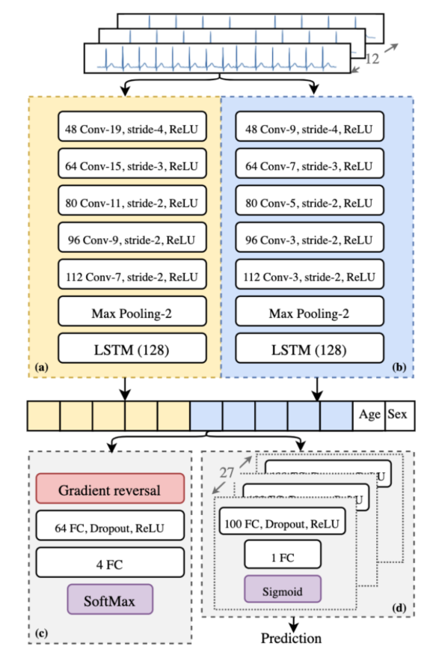
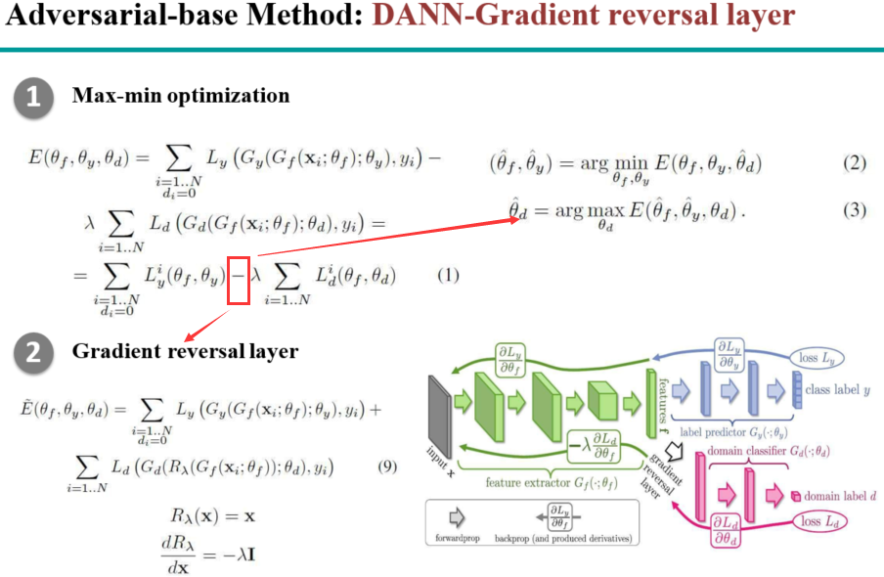
Adversarial multi-source domain generalization

Slide 21
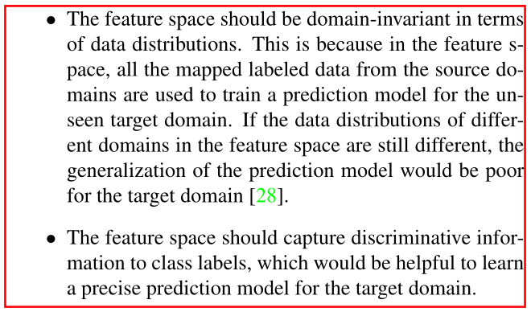
Domain Generalization with Adversarial Feature Learning (CVPR2018)
A novel framework based on adversarial auto encoders to learn a generalized latent feature representation across domains.
Basic assumption: there is a feature space underlying the seen multiple source domains and the unseen target domain.

Slide 22
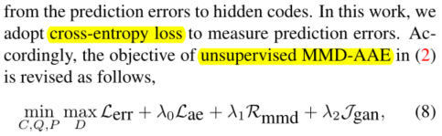
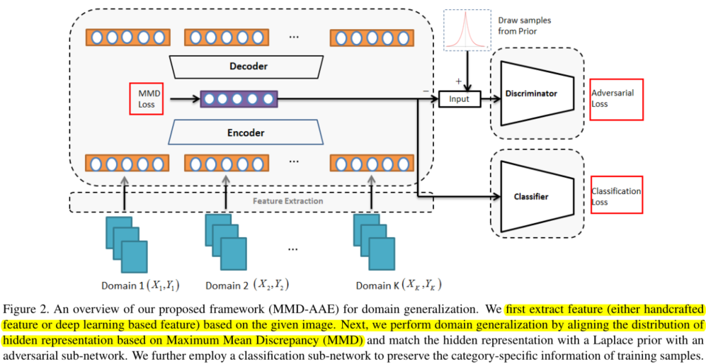
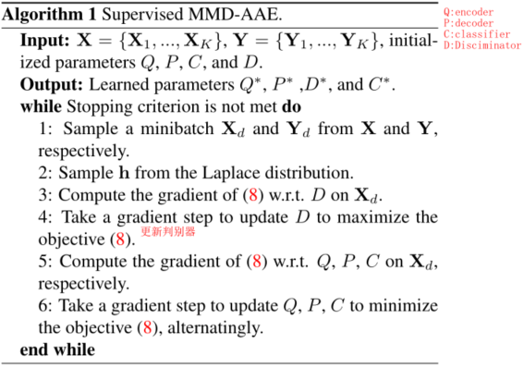
Method
probabilistic autoencoder + MMD in an adversarial learning manner (MMD-AAE)
With the introduced prior distribution, we expect the learned feature space is not overfitted to the seen domains
Jointly minimize the classification loss, reconstruction loss as well as the MMD loss.

